Slide 1
Colorado Online @ Information Session: CCCS Online Library
March 22, 2023

Slide 2
Colorado Online @ Consortium Model Goals
Rationale | Goals
Meet student needs | Ensure equity of access & success Improve ease of use for students
Compliance with accreditation criteria | College oversight, improve efficiency, leverage existing state online investments
Growing student demand for online learning | Increase capacity, grow enrollment Offer more fully online programs Increase workforce & noncredit options Attract new markets
Economic ability to serve current & future students | Reduce internal competition, become more competitive externally Increase revenue, improve use of resources at a lower cost to students
Support existing CCCS efforts | Expand opportunities via technology

Slide 3
Rationale for CCCS Online Library
The CCCS Online Library’s focus is equity in access and experience
Serve all CCCS constituents, regardless of campus, course modality, or student location
Develop an equitable library collection, ensuring that resources are available to meet the educational requirements of all courses, departments, programs, and degrees to the greatest extent possible
Provide modern library services and resources for all:
discovery search, chat service, research guides, and authentication
Improve the student experience by removing the multi-library, multi-login, and changing collection incidents
Notes:
Brittany will cover how the CCCS Library and CCD/Auraria will work later, but CCD will retain it's access to Auraria Library.

Slide 4
Colorado Online Library Deliverable:
Determine base level of library services available to all students, and how they are managed (centrally, locally)

Slide 5
Centralized Online Library Recommendation
Coordinated CCCS Central Library, respecting autonomy for local libraries
Resources (Online Collection)
Single authentication method
Centralized online collection for all without partitioning, with same access to databases, ebooks, streaming media, discovery search, research guides
EXCEPTION: those resources currently purchased by departments
Leave circulation system (physical collection) independent
Services
Expanded online chat and online information literacy instruction
System library committees
Central librarians to help support library services and resources

Slide 6
 | CCCS Online Library
Accreditation Requirements | Meets HLC, NAECY, ARC-PA, and CCNE accreditation requirements
Bachelor’s & Master’s Programs | Supports curricular and degree program needs across CCCS (including bachelor’s and master’s programs)
Database Partitioning | No partitioning of any databases, ensuring all library users will have access to the entire collection
Current Collection Changes | Provides equity in library collections to all CCCS students, faculty, instructors, and staff regardless of location, program, or course modality
Current Service Changes | Move towards parity in library services, such as online chat, research appointments, online instruction, and centralized research/course guides
Local Library Autonomy | Decisions to use CCCS Library or college library website; publishing local library research/course guides; how instruction, research appointments, and chat reference will be conducted; how to work with faculty; embedded librarianship
CCD and Auraria Library | Colorado Online sections (pooled and wildcard) should use CCCS Library Resources, as all CCCS students and CCD Online students have access to the same collection. Other CCD sections will retain access to the Auraria Library Collections and Services.
National Library Standards | Exceeds Association of College and Research Libraries modern library expectations/recommendations
Notes:
See final three slides for actual collection recommendations.

Slide 7
Key dates and information:
April 3, 2023: Internal Access Opens
Faculty, instructors, and staff from across CCCS can access the new library collections
These links are durable and can be included for Summer 2023 courses
May 1, 2023: CCCS Access Opens
The public CCCS Online Library website and collections become available
May 9-29, 2023: College Library Resources and Links Transition
Between the Spring and Summer Semesters, College Libraries will transition their library links and resources to the CCCS Library.
The level of change may vary from College to College:
Some colleges may keep their brand, so you may only notice logins and resources change
Some colleges may transfer some library webpages to the CCCS Library so there may be more of a change
Summer Semester: Pilot and evaluation

Slide 8
CCCS Library Online Collection | Coverage | Accreditation Requirement
CLIC Package | Multidisciplinary | HLC
ProQuest Central | Multidisciplinary | HLC
Nursing and Allied Health Premium | Allied Health | CCNE
JSTOR (Entire collection) | Multidisciplinary | HLC
Films on Demand | Multidisciplinary | HLC
Credo Reference | Multidisciplinary | ACRL
Blooms Literature | Multidisciplinary | HLC
Science Direct | Allied Health | HLC, CCNE, ARC-PA
American Journal of Nursing | Allied Health | CCNE, ARC-PA
Statista | Business | HLC
Articles on Demand (ECE) | Early Childhood | NAEYC
Ed.Flicks (ECE) | Early Childhood | NAEYC
Access Medicine | Allied Health | ARC-PA
STASH | Multidisciplinary | HLC
ArtStor | Multidisciplinary | HLC
EBSCO EDS (Discovery) | Other | No
Academic eBook Collection | Multidisciplinary | HLC
CINAHL Plus Full Text | Multidisciplinary | CCNE, ARC-PA
Opposing Viewpoints | Multidisciplinary | HLC
Gale InContext: World History | Multidisciplinary | HLC
Gale InContext: US History | Multidisciplinary | HLC
Gale Business: Entrepreneurship | Business | HLC
Interactive Human Anatomy | Allied Health | CCNE, ARC-PA
National New Play Network | Theatre | HLC
Perpetual Access to Ebooks and Streaming Media | Multidisciplinary | HLC, CCNE, ARC-PA, NAEYC

Slide 9
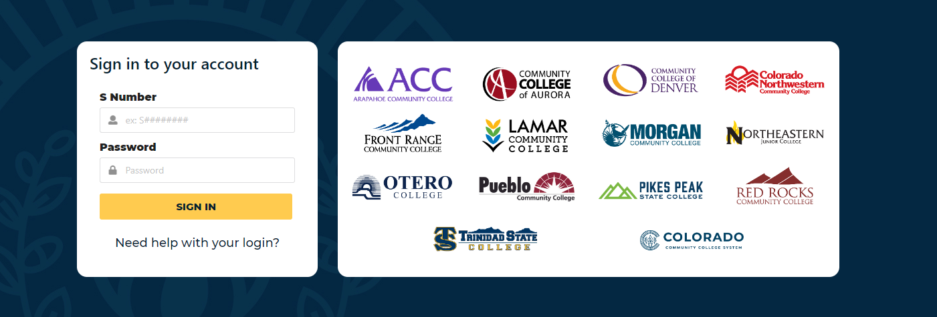
Access
All URLs for resources access will be uniform across CCCS
Single sign on (SSO)

Slide 10
CCCS Library Online Services
All CCCS students, faculty, and staff will have access to
Online chat and reference/research help appointments
Online library instruction or orientations
Libguides, research, and/or course guides
Training and professional development
Local College Libraries will still provide personalized library services to college faculty:
Instruction sessions
Faculty and librarian partnerships

Slide 11
What you need to know for this transition
If you currently use library links, you will need to update them after Spring Semester
Talk to your local librarian for assistance with:
Transition timelines
Locating and linking to resources
Coffee preferences
How to get help:
Local library and librarians
Email CCCS Library at cccolibrarian.online@cccs.edu

