Slide 1
Colorado Online @ Instructor Orientation
May 16, 2023

Slide 2
Colorado Online @ Consortium Model Goals
Rationale | Goals
Meet student needs | Ensure equity of access & success Improve ease of use for students
Compliance with accreditation criteria | College oversight, improve efficiency, leverage existing state online investments
Growing student demand for online learning | Increase capacity, grow enrollment Offer more fully online programs Increase workforce & noncredit options Attract new markets
Economic ability to serve current & future students | Reduce internal competition, become more competitive externally Increase revenue, improve use of resources at a lower cost to students
Support existing CCCS efforts | Expand opportunities via technology

Slide 3
Welcome to Colorado Online!
An overview of section assignments
Course materials used in pooled sections
Accessing instructor resource shells
New CCCS Online Library
Contact information
Important dates, and reporting no-shows
Accessing your roster and enter grades
Syllabus checklist
Q&A

Slide 4
Colorado Online @ sections
Students at each college
Home College section
only open to students at one college
Enrollment cap = 34
Pooled section
open to all CCCS students
No enrollment cap*
Teaching section X01
Enrollment cap = 34
Teaching section X00
Enrollment cap = 34
REGISTRATION
SPLIT
Notes:
John

Slide 5
Teaching sections use common course materials
Students from all 13 colleges may enroll in Pooled sections
Federal regulations require listing specific course materials and costs so that students have that information when they register
All teaching sections of pooled courses use course materials selected by state discipline faculty.
See the list of materials and get copy access to instructor resource shells in D2L at:
https://at.ccconline.org/coursematerials/
Notes:
Tammy

Slide 6
Library Resources
Starting this summer, students and faculty at all CCCS colleges will have access to a shared online library by the first day of class.
If you plan to use a course from a previous semester, be sure to update any direct links to specific library materials.
Notes:
Brittany

Slide 7
Contact Information
Service | Contact Info
24x7 Technology Help Desk | http://help.cccs.edu 1-888-800-9198
Tutoring (provided online through TutorMe) | Use direct link in D2L
Library | https://cccs.libguides.com/librarycentral Email: cccolibrarian.online@cccs.edu
Student Support Team / Online Success Liaisons | Email: studentsuccess@cccs.edu Toll Free: 1-844-878-2764
Notes:
Frank

Slide 8
Important dates for Colorado Online sections
Event | 10-week term | 7-week term
Registration starts | 3/13/2023 | 3/13/2023
Students placed into Teaching sections | 5/24/2023 | 5/24/2023
First day of classes | 5/30/2023 | 6/20/2023
Census1 / enter no-shows | 6/8/2023 | 6/27/2023
Census2 / withdrawal date | 7/25/2023 | 7/28/2023
Last day of classes | 8/6/2023 | 8/6/2023
Enter grades | 8/9/2023 | 8/9/2023
Notes:
Lisa

Slide 9
Report No-Shows
Students who do not participate in an academic manner need to be reported for non-attendance no later than Census 1 so that they can be dropped from the class.
Logging into an online course or only posting an introduction does not count as attendance.
Be sure to include information in your syllabus.
Example
Students establish attendance in online and real-time remote courses by completing an academic activity based on course content. As defined by the Federal Department of Education, merely logging into the course site or introducing oneself to the class does not count as attendance. Some examples of successfully attending class include participation in a content-related discussion in the MyCourses discussion board or in WebEx/Zoom, taking a quiz, submitting an assignment, or contacting your instructor with a content related question. Students who have not participated by 11:59 PM on the deadline date will be dropped. Similarly, the last date of academic attendance must be reported to Financial Aid for students who do not earn a D or better; students who have not been in regular attendance may experience financial aid ramifications.
Notes:
Lisa

Slide 10
Portal dashboard – Colorado Online functions
Notes:
Frank

Slide 11
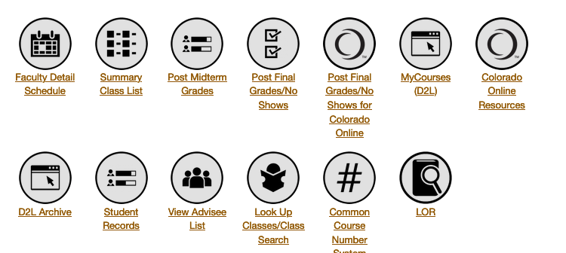
Portal Dashboard
Notes:
Frank

Slide 12
Syllabus Checklist
Check that your start and end dates align with Important Dates for the part of term in which you are teaching (previous slide, SharePoint site)
Include a statement about Academic Attendance. Students who do not participate in an academic manner by the census date for the class will be dropped.
Include contact information
You
24x7 Help Desk
CCCS Student Support Team
Notes:
Tammy

Slide 13
Q&A

