Slide 1
Colorado Online @ Information Session: Finding Information
March 7, 2023

Slide 2
Colorado Online @ Consortium Model Goals
Rationale | Goals
Meet student needs | Ensure equity of access & success Improve ease of use for students
Compliance with accreditation criteria | College oversight, improve efficiency, leverage existing state online investments
Growing student demand for online learning | Increase capacity, grow enrollment Offer more fully online programs Increase workforce & noncredit options Attract new markets
Economic ability to serve current & future students | Reduce internal competition, become more competitive externally Increase revenue, improve use of resources at a lower cost to students
Support existing CCCS efforts | Expand opportunities via technology

Slide 3
Communication
Monthly email updates from Executive Sponsor, Landon Pirius
Colorado Online @ Project Blog (https://coloradoonline.cccs.edu)
Updates, FAQs, virtual suggestion box, recordings from open forums and training sessions
Member lists for Project Teams, Subcommittees, and the Online Faculty and Instructor Advisory Committee
Zoom Info Sessions every other week – Wednesdays @8:00 am - 8:30 am
New: Q&A Sessions on the opposite weeks
March 15 -- Academic Affairs – Tammy Vercauteren
March 29 -- Student Affairs – John Schmahl
Updates from college leadership and project / committee reps

Slide 4
Colorado Online @ Blog Site
Subcommittee charges, recommendations and membership
Healthy course checklist and access to training
Upcoming events and due dates
Course materials
Spring pilot
Info session recordings
Monthly updates
Resources: CCCS Colorado Online SharePoint
Coming soon: Inside Colorado Online @ Web Site
Notes:
Subcommittee charges, recommendations and membership
Healthy course checklist and access to training
Upcoming events and due dates
Course materials
Spring pilot
Info session recordings
Monthly updates
Resources: link to new CCCS Colorado Online SharePoint
Coming soon: Inside Colorado Online @ Web Site

Slide 5
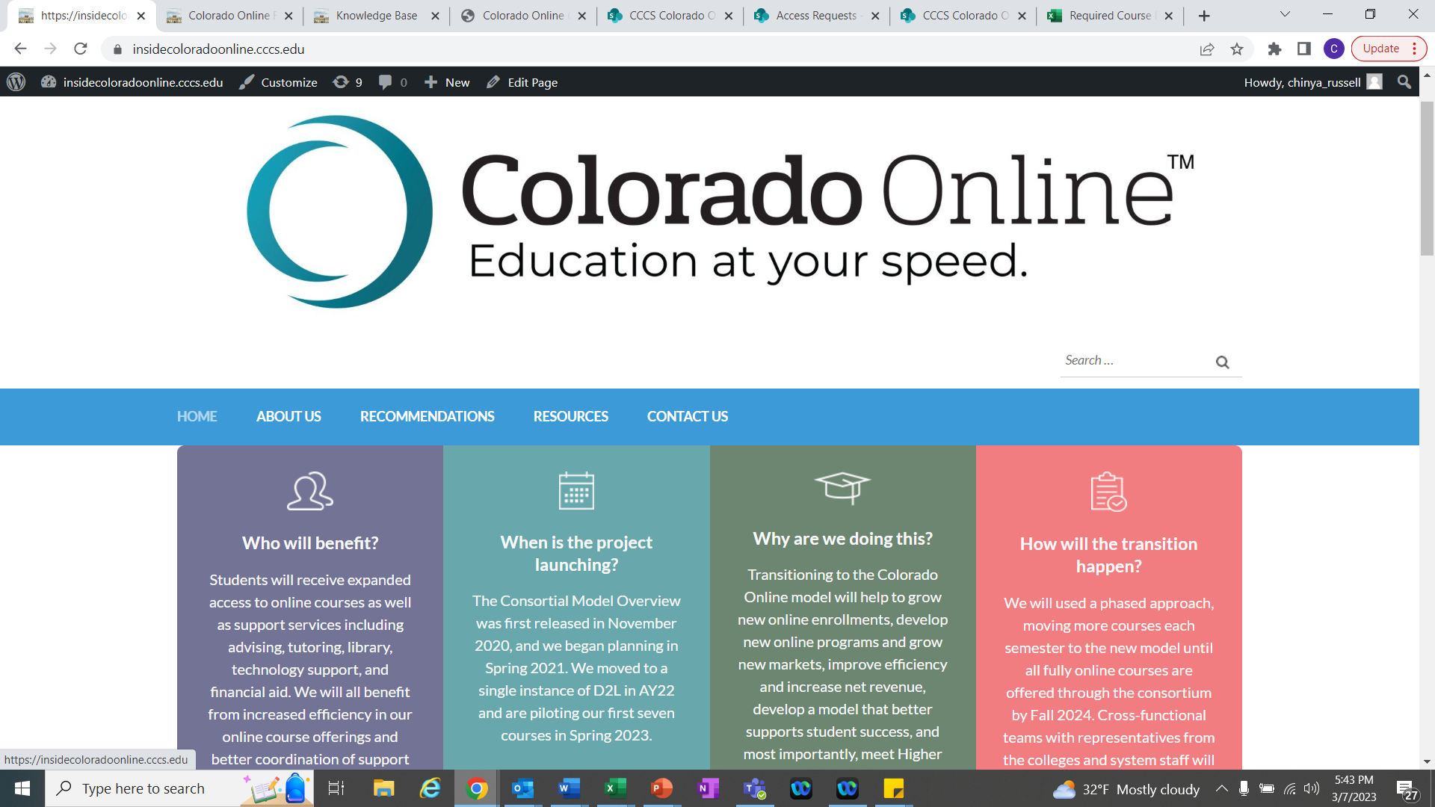
Coming Soon…

Slide 6
CCCS Colorado Online SharePoint
First-time Users Request Access
Allow 1-2 days
View
Contact Information
Course Materials – instructions, required materials, existing integrations
Course Section Distribution – by semester, next change
Course Transition Timeline
Instructor Resources
Notes:
Request access; Allow 1-2 days
Contact Information
Course Materials
Instructions for Selecting Course Materials
Required Materials for Pooled Sections
Existing Digital Integrations
Course Section Distribution
Section Distribution by Semester
Net Change by College
Course Transition Timeline
Instructor Resources

Slide 7
D2L
Resources for Students in Pooled Sections in Navigation Bar
24x7 Support Desk and Tutoring
Students in pooled sections are automatically enrolled in Online Student Orientation that appears on course dashboard
Resources for Instructors
KB Articles
Blank course shells are created when instructor is assigned in Banner
Coming Soon (est. end of March): Form to request access to required course materials and resource shells in D2L (RTT, Interim Course Shells, Wireframe)

Slide 8
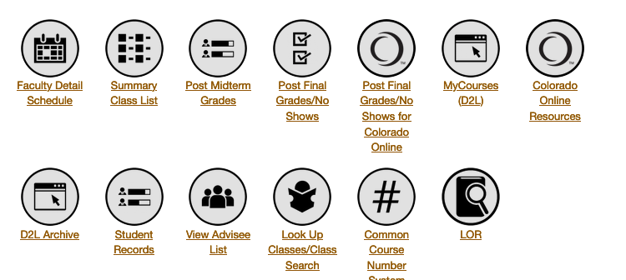
Portal
Access class roster
Report no shows
Enter grades

Slide 9
Where to Find Job Opportunities
College job boards
Colleges are invited to post openings on central job board for additional exposure through social media and referrals: https://jobs.cccs.edu/
Teaching Semester | Job Postings Typically Begin*
Summer | February / March
Fall | March
Spring | September / October
* Many colleges hire year round

Slide 10
Contact Us!
Executive Sponsor, Landon Pirius – landon.pirius@cccs.edu
Project Director, Tammy Vercauteren – tammy.vercauteren@cccs.edu
Project Coordinator, Chin Ya Russell – chinya.russell@cccs.edu

