Slide 1
Colorado Online @ Fall 2023 Update
August 30, 2023

Slide 2
Colorado Online @ Consortium Model Goals
Rationale | Goals
Meet student needs | Ensure equity of access & success Improve ease of use for students
Compliance with accreditation criteria | College oversight, improve efficiency, leverage existing state online investments
Growing student demand for online learning | Increase capacity, grow enrollment Offer more fully online programs Increase workforce & noncredit options Attract new markets
Economic ability to serve current & future students | Reduce internal competition, become more competitive externally Increase revenue, improve use of resources at a lower cost to students
Support existing CCCS efforts | Expand opportunities via technology
Colorado Online @ Consortial Model Overview (November 11, 2020)
Notes:
Tammy

Slide 3
Fall 2023 Courses
Home College Sections
482 sections – all parts of term
Pooled Teaching Sections
15 – week – 199
1st 7-week – 29
As of the Split meeting (8/16/2023), colleges had not yet built 12 sections in Banner; 14 sections were built, but no instructor was assigned
We requested an additional 13 15-week sections and 3 7-week teaching sections at the split meeting
23 sections were added between the split meeting and 8/23

Slide 4
CO@ Enrollment analysis – Fall 2023 15, and 1st 7-week
 | Total | Home College sections | Teaching sections from pooled reg.
Enrollment | 19,402 | 12,848 | 6,554*
Final # sections | 710 | 482 | 228*
Avg section size | 27.3 | 26.7 | 28.8
Totals do not include sessions that have not started.
Late surge in enrollments required adding several additional Pooled Teaching sections.
6 Pooled Teaching sections canceled due to lower than expected enrollments in those courses.

Slide 5
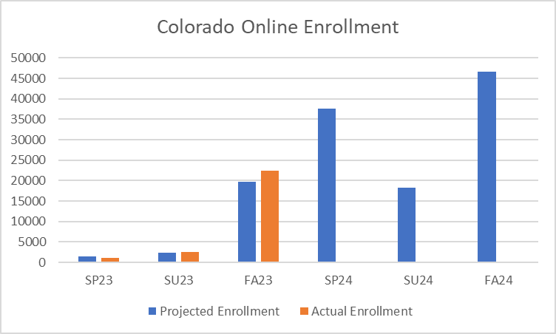
Colorado Online - Projected vs. Actual Enrollment

Slide 6
What worked well
The Sectionizer
Aggregating enrollments
Prioritizing placement of students in sections taught by home colleges where possible
Quick, collaborative response by colleges to add sections when there was a critical need (actual enrollment)

Slide 7
Improvements over summer
Establishment of Learning Design Community of Practice – co-chaired by reps from colleges and CCCS team
Development of extended support resources for faculty and instructors
Learning Resource Coordinator hired in July to support course materials processes, closer link with learning design
College Implementation Leads identified by all colleges, began meeting jointly in July

Slide 8
Challenges
Higher enrollment than anticipated, including concurrent enrollment
Capacity in Z-sections not linked to capacity in teaching sections, allowing enrollment to quickly exceed teaching capacity
Planned sections not completely built out by colleges / instructors not assigned by first day of class
Reluctance to build or staff too many sections
High number of fraudulent enrollments over summer
Concerns regarding inconvenience fee
Co-reqs not set in Banner for Z sections required manual placement

Slide 9
Changes moving forward
Continued training of college and CCCS staff
Fill vacant scheduler and online success liaison positions
Verify that section builds are complete and accurate in Banner
Section numbers for spring will reflect the order in which they will be filled, streamlining and adding predictability to the course cancelation process
Simplify and distribute information gathering processes using online forms and workflows
Strengthen college implementation teams and communication network

Slide 10
Changes moving forward (continued)
Apply co-req controls to Z sections in Banner to avoid manual placements
Continue to refine sectionizer / Banner integration:
X sections to show up in more reports
Student and instructor emails included in export files
Other issues as identified (e.g. automatically resetting caps to 0 in teaching sections is preventing instructors from reporting no shows)
Find ways to incentivize colleges to volunteer for extra sections in advance

Slide 11
Other steps being considered:
Processes for adding home college sections in specific circumstances
Incentivize colleges to assign instructors to pooled sections
Reimburse colleges for inconvenience fees if pooled teaching sections need to be canceled within two weeks of term start
Sections without instructors assigned are the first to be canceled

Slide 12
Where to Find Information
Info Sessions (8:00 am every other Wednesday)
Monthly email updates from Executive Sponsor, Landon Pirius
Updates from college leadership and project / committee reps
Inside Colorado Online (https://insidecoloradoonline.cccs.edu)
Bi-weekly updates, FAQs, virtual suggestion box
Member lists for Project Teams, Subcommittees, and the Online Faculty and Instructor Advisory Committee
CCCS Colorado Online SharePoint for documents (course section distribution, enrollment reports, course materials selections, etc.) -- Access must be approved at first login
Contact us!
Executive Sponsor, Landon Pirius – landon.pirius@cccs.edu
Project Director, Tammy Vercauteren – tammy.vercauteren@cccs.edu
Project Coordinator, Chin Ya Russell – chinya.russell@cccs.edu
Notes:
Thank you for taking the time to learn more about this important project and for your feedback.

