Slide 1

Colorado Online @
Instructor Orientation
For instructors teaching Colorado Online @ pooled sections
(10-week session), Sept. 2023

Slide 2


Welcome to Colorado Online!
Goals of Colorado Online
Types of Colorado Online sections
Pooled teaching sections require common course materials, new CCCS Online library
View required course materials and optional teaching resource shells
Student support services and contact information
Important dates, and reporting no-shows
Accessing your roster and entering grades
Resources for help with your course
Course readiness checklist
Q&A
Notes:
Tammy

Slide 3
Colorado Online @ Consortium Model Goals
Rationale | Goals
Meet student needs | Ensure equity of access & success Improve ease of use for students
Compliance with accreditation criteria | College oversight, improve efficiency, leverage existing state online investments
Growing student demand for online learning | Increase capacity, grow enrollment Offer more fully online programs Increase workforce & noncredit options Attract new markets
Economic ability to serve current & future students | Reduce internal competition, become more competitive externally Increase revenue, improve use of resources at a lower cost to students
Support existing CCCS efforts | Expand opportunities via technology
Colorado Online @ Consortial Model Overview (November 11, 2020)
Notes:
Tammy

Slide 4

Colorado Online @ Types of Sections
Students at each college
Home College section
only open to students at one college
Pooled Registration section
Combined enrollment from all colleges
Pooled Teaching section
Pooled Teaching section
REGISTRATION
%CY
%CZ
SPLIT
%CX
%CX
Notes:
John

Slide 5

Library Resources
Starting Summer 2023, students and faculty at all CCCS colleges have access to the shared online library.
If you plan to use a course from a previous semester, all links need to point to the CCCS Library, so be sure to check your course.
Access this webinar recording in which Marcus Elmore, CCCS Access Services Librarian, identifies links which need to be updated and the process for doing so. An overview of the new online library and discovery service is included. (Access recording on Sharepoint)
Notes:
Learning Resources: Marcus or Brittany

Slide 6
Pooled Teaching Sections use Common Course Materials
Students from all 13 colleges may enroll in Pooled sections
Federal regulations require listing specific course materials (textbooks, labkits, etc.) and their costs so that students have that information when they register
All teaching sections of pooled courses use course materials selected by state discipline faculty.
See the list of materials and get copy access to optional Teaching Resource Shells in D2L at:
https://at.ccconline.org/coursematerials/
Notes:
Learning Design: Brittany
Note: Michael Make Additions
Add slide that covers types of course shell resources
Add a screen capture of the Copy form

Slide 7
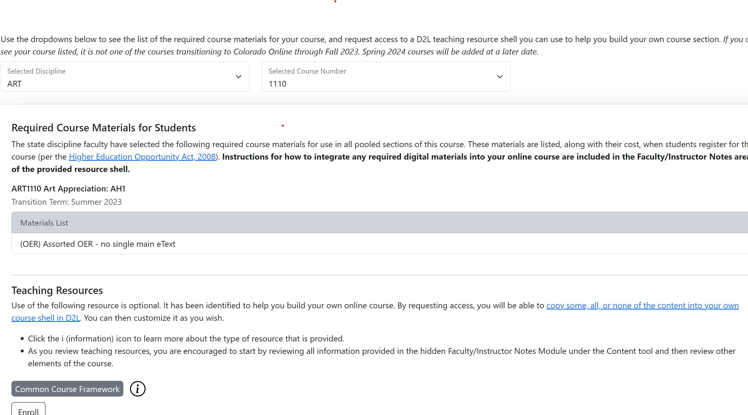

View of Required Materials and Teaching Resources
https://at.ccconline.org/coursematerials/
Notes:
Learning Design: Michael Murphy, Stephanie Wickman
(Mention – link will help with copy assistance)
Note: Michael Make Additions
Add slide that covers types of course shell resources
Add a screen capture of the Copy form

Slide 8
Different types of Teaching Resource Shells
State Discipline Submitted Course Shell. This is an existing D2L shell identified by state discipline faculty as a resource for instructors. The resource is provided as-is and may not be fully accessible. Where possible, feedback on certain criteria of the Healthy Course Checklist is provided: basic learner guidance, assessment of measurable outcomes, alignment with common course learning outcomes (CCNS), and accessibility. *
CCCS Supplied Course Shell. This is an existing CCCOnline D2L shell that was supplied by CCCS. The resource is provided as-is and may not be fully accessible. Where possible, feedback on certain criteria of the Healthy Course Checklist is provided in the form of a course readiness report: basic learner guidance, assessment of measurable outcomes, alignment with common course learning outcomes (CCNS), and accessibility. *
Ready-to-Teach Course Shell. This online course shell has been developed and reviewed by state discipline faculty across colleges using the collaborative learning design process. It uses the required materials for pooled sections (listed above) and has been reviewed for alignment with CCCNS guidelines, the Healthy Course Checklist, and accessibility requirements. *
Common Course Framework. This course shell includes instructions on how to apply the Common Course Framework in your online course. There is no specific course content. *
* All readiness reports can be found in the hidden Faculty/Instructor Notes Module under the Content tool. ALL shells will be in different states of readiness. Thus, some shells will be blank forms or may have little content. This is based on what was submitted or supplied by your discipline as a shell. Questions regarding your shells, should be referred back to your State Discipline Chair and/or your local Learning Design team first.
Notes:
Learning Design: Michael Murphy, Stephanie Wickman
Note: Michael Make Additions
Add slide that covers types of course shell resources
Add a screen capture of the Copy form
Emphasize that use is optional.

Slide 9
Student Support Services
Service | Contact Info
24x7 Help Desk (D2L and technology support included) | http://help.cccs.edu 1-888-800-9198
Tutoring (provided online through TutorMe) | Use direct link in D2L
Library | https://cccs.libguides.com/librarycentral Email: cccolibrarian.online@cccs.edu
Student Support Team / Online Success Liaisons | Email: studentsuccess@cccs.edu Toll Free: 1-844-878-2764
Notes:
Student Services: John or Julianne

Slide 10
Important dates for Colorado Online sections
Event | 15-week | 1st 7-week | 10-week term | 2nd 7-week
Students placed into Teaching sections | 8/16/2023 | 8/16/2023 | 9/19/2023 | 10/11/2023
First day of classes | 8/21/2023 | 8/21/2023 | 9/25/2023 | 10/16/2023
Census1 / enter no-shows | 9/6/2023 | 8/29/2023 | 10/4/2023 | 10/24/2023
Census2 / withdrawal date | 11/16/2023 | 9/28/2023 | 11/27/2023 | 12/1/2023
Last day of classes | 12/10/2023 | 10/8/2023 | 12/10/2023 | 12/10/2023
Enter grades | 12/13/2023 | 10/11/2023 | 12/13/2023 | 12/13/2023
Notes:
Student Services: John or Julianne

Slide 11
Report No-Shows
Students who do not participate in an academic manner need to be reported for non-attendance no later than Census 1 so that they can be dropped from the class.
Logging into an online course or only posting an introduction does not count as attendance.
Be sure to include information in your syllabus.
Example
Students establish attendance in online and real-time remote courses by completing an academic activity based on course content. As defined by the Federal Department of Education, merely logging into the course site or introducing oneself to the class does not count as attendance. Some examples of successfully attending class include participation in a content-related discussion in the MyCourses discussion board or in WebEx/Zoom, taking a quiz, submitting an assignment, or contacting your instructor with a content related question. Students who have not participated by 11:59 PM on the deadline date will be dropped. Similarly, the last date of academic attendance must be reported to Financial Aid for students who do not earn a D or better; students who have not been in regular attendance may experience financial aid ramifications.
Notes:
Student Services: John or Julianne

Slide 12

Viewing Your Roster and Gradebook
The roster for your pooled teaching section will be available in Banner once the sectionizer runs (~Sept. 20, 2023)
Grades will also be entered directly in Banner using the same processes you would for your campus-based courses.
Notes:
John or Frank

Slide 13
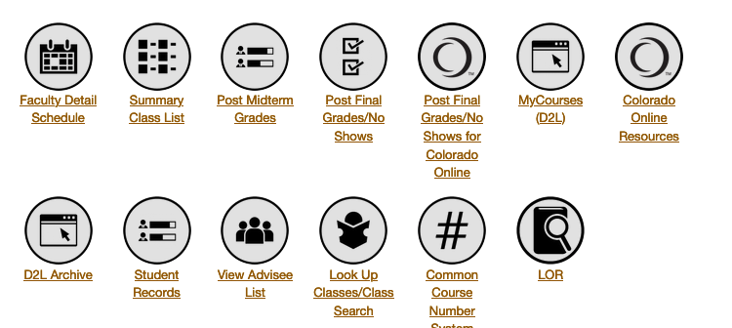
Portal dashboard – Colorado Online functions
Notes:
Technology: Frank, Kristin
Note – Frank will mention this is changing

Slide 14

More Resources for Help with Your Course
Your home college is your first and priority resource as you reach out for help. However, if you need assistance outside of what your college offers, CCCS support options are available.
PD course for Pooled Section instructors: The Colorado Online Professional Development Faculty Resources course is designed to help faculty and instructors prepare a pooled section for Fall 2023, and assist them with online course essentials, which include tech support and accessibility. Pooled instructors are auto-enrolled in this course in D2L. Others may self-enroll through this enrollment form.
General self-access technical support is accessible at the CCCS Knowledgebase.
Extended night and evening technical support is available for faculty/instructors:
• For 24x7 Support Desk assistance, call 1-888-800-9198 or request help at http://help.cccs.edu.
• NOTE: faculty and Instructors may also contact extended-hour tier 2 support (5pm – 9pm M – F and 8am – 5pm S/S) directly by calling (720) 858-2900 or e-mailing at.support.online@cccs.edu. Tier 2 (advanced knowledge of technologies) is usually the type of help instructors need.
Colorado Online Pooled Course Readiness Checklist
Notes:
Liz

Slide 15
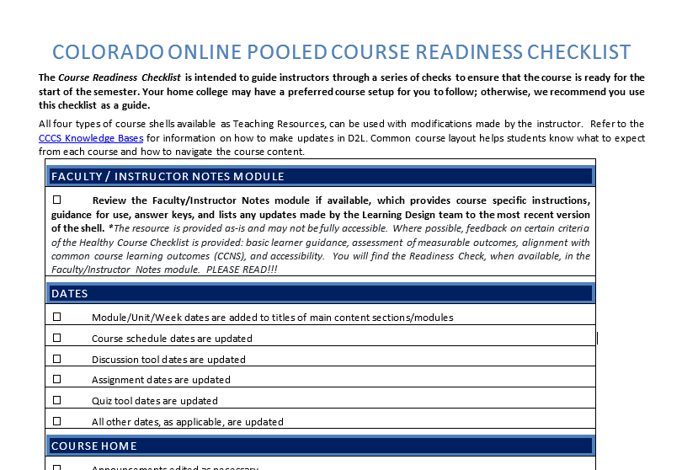
Course Readiness Checklist
Use the Colorado Online Pooled Course Readiness Checklist
Word doc you can download [also in Faculty Resources course]
Notes:
Liz

Slide 16
Other Faculty Support Services
Service | Contact Info
Course Materials | Rachel.meisner@cccs.edu
Learning Design | COLearningDesign@cccs.edu
Library | https://cccs.libguides.com/librarycentral Email: cccolibrarian.online@cccs.edu
Notes:
Rachel

Slide 17
Q&A

Slide 18
Stay up to date on the transition to Colorado Online
Info Sessions (8:00 am every other Wednesday starting August 30)
Monthly email updates from Executive Sponsor, Landon Pirius
Updates from college leadership and project / committee reps
Inside Colorado Online (https://insidecoloradoonline.cccs.edu)
  Bi-weekly updates, FAQs, virtual suggestion box
  Member lists for Project Teams, Subcommittees, and the Online Faculty and Instructor Advisory Committee
CCCS Colorado Online SharePoint for documents (course section distribution, enrollment reports, course materials selections, etc.) -- Access must be approved at first login
Contact us!
  Executive Sponsor, Landon Pirius – landon.pirius@cccs.edu
  Project Director, Tammy Vercauteren – tammy.vercauteren@cccs.edu
  Project Coordinator, Chin Ya Russell – chinya.russell@cccs.edu
Notes:
Tammy
Thank you for taking the time to learn more about this important project and for your feedback.

